Slide 1
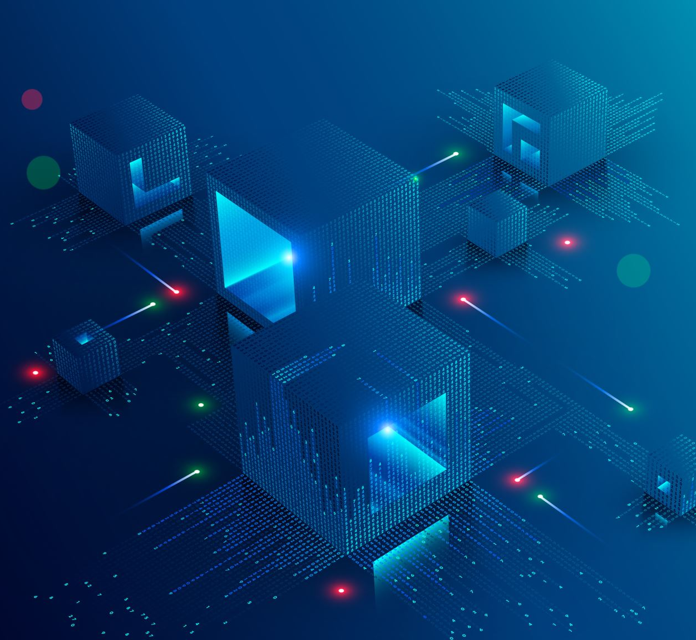
Session 13
C# and Unity Recap

